Slide 1
LO: To work out the area of a shape by counting rectangles
Session 1

Slide 2
Revision
Before Christmas we looked a the ‘perimeter’ of a shape, which was the distance around the outside of a shape. Let’s remind ourselves.

Slide 3
What is the perimeter of this shape?
Remember, perimeter is the distance around the outside of the shape.
The perimeter of this shape is 22cm

Slide 4
What is the perimeter of this shape?
Remember, perimeter is the distance around the outside of the shape.
The perimeter of this shape is 28cm

Slide 5
18cm
18cm
What is the perimeter of each of these shapes?
Jot your answers down on a piece of paper.
22cm
18cm
26cm

Slide 6
So now let’s look at the area of a shape.
The area of a shape is the amount of space inside it.

Slide 7
To find out how much shape is inside we can
count the squares.
The area of a shape is the amount of space inside it.
The area of this shape is 18cm².

Slide 8
What is the area of this shape?
The area of a shape is the amount of space inside it.
The area of this shape is 48cm².

Slide 9
18cm²
20cm²
What is the area of each of these shapes?
Jot your answers down on a piece of paper.
30cm²
14cm²
22cm²

Slide 10
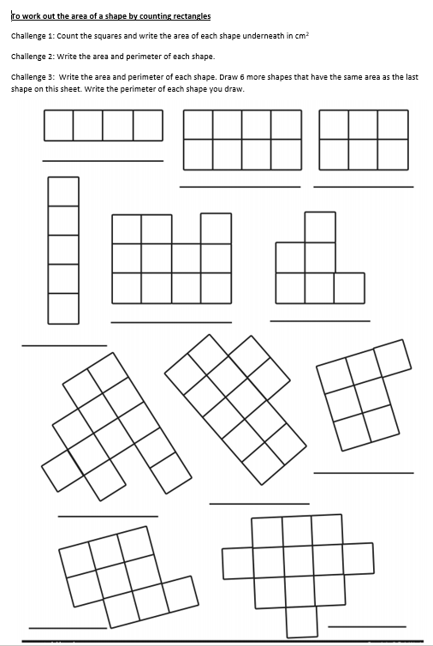
Today’s Task:
There is a worksheet on assignments which has 3 challenges for you to choose from.

Slide 11
LO: To work out the area of a shape
Session 2

Slide 12
Starter:

Slide 13
Let’s have another look at working out the area by counting squares.

Slide 14
cm²
Imagine each of these squares is 1cm × 1cm.
That means the area of each little square is 1cm². (Just like the blue square!)
1cm²
32cm²
Can you find the area of the green rectangle by counting the squares?
Can you find the area of the pink shape?
15cm²

Slide 15
Strange Shapes
Some shapes are difficult to count exactly because they don’t fill up whole squares. The easy way to remember is to count the whole squares first. Add any squares which fill half or more and ignore the squares which cover less than half the square.
1cm²
27cm²
27cm²
Have a go at finding the area of these 2 shapes. Once you think you know the area, type it into the chat feed.

Slide 16
Estimating
Because we didn’t know the exact area for the two previous sides, we made a guess. This is called an estimate. We didn't just randomly guess, though; we used our knowledge and skills and made an educated guess.
1cm²

Slide 17
Estimate
1cm²
Can you estimate the area of this shape?
Check the area by counting the squares.
26cm²

Slide 18
Estimate
1cm²
Can you estimate the area of this shape?
Check the area by counting the squares.
24cm²

Slide 19
Estimate
1cm²
Can you estimate the area of this shape?
Check the area by counting the squares.
32cm²

Slide 20
Estimate
1cm²
Can you estimate the area of this shape?
Check the area by counting the squares.
24cm²

Slide 21
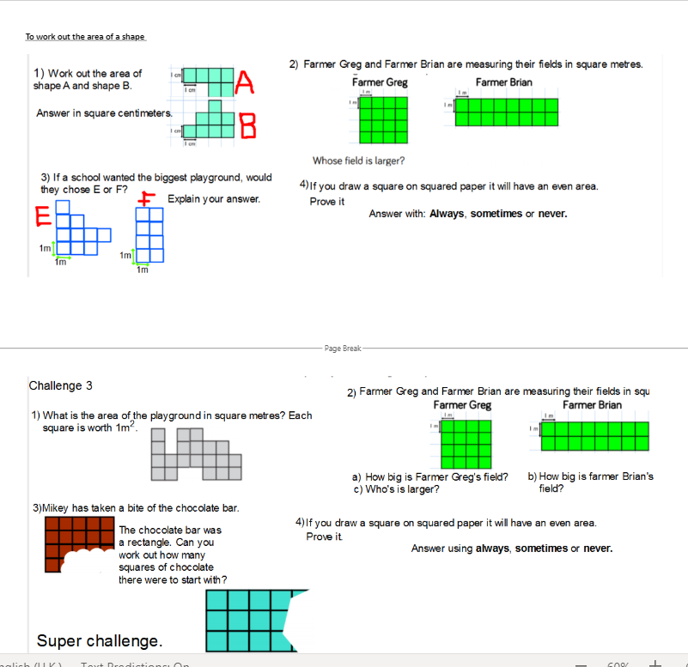
Today’s task:
Choose your challenge to complete.
Saved in Assignments.

Slide 22
LO: Working with the area of rectangles
Session 3

Slide 23
Area of a Rectangle
Explain without counting all the squares, why the area of this rectangle is 15 squares.
The rectangle is 3 rows of 5 squares, which can be calculated by multiplying 5 and 3 to gain the answer of 15 squares.
Show
Answers
Hide
Answers

Slide 24
The rectangle is made of 6 rows of 8 squares.
In Maths the word “of” means multiply.
To work out the number of squares
we times 6 by 8.
Counting each square can take a long time. Does anyone know a quicker way?
The area of the shape is 48cm².

Slide 25
Square Centimetres
What different rectangles (rectilinear shapes) have an area of 12 cm². Put your hand up if you know one.
Your times tables will help you here.
Show
Answers
Hide
Answers

Slide 26
Today’s task:
Have a go at these 3 challenges.
Saved in Assignments.

Slide 27
LO: Comparing the area of rectilinear
Session 4

Slide 28
Comparing Area
Diving
 | A
 |  |  |  |  |  | E
 | B
 | C |  |  |  |  | F
 |  | D
 |  |  |  |  |  | G
Sort the shapes into the correct column of the table.
Shapes with an Area Greater Than 6 Squares | Shapes with an Area Less Than 6 Squares
A
D
E
B
C
F
G

Slide 29
Comparing Area
Diving
Complete the table. Use the squares to calculate the area of each shape. Compare the areas of the shapes using >, < or =.
Shape 1 | Compare Area >, < or = | Shape 2
>
11
>
10

Slide 30
Comparing Area
Diving
 |  | A |  |  |  | B
 |  |  |  |  |  |  |  |  |  |  | C
Order these shapes from the shape with the smallest area to the shape with the largest area.
C, A, B

Slide 31
Comparing Area
Deeper
 | A |  |  | B |  |  |  | C |  |  |  | D
A
C
D
Jessica has been asked to order the shapes from the shape with the smallest area to the shape with the largest area.
She has got confused. Explain her mistake.
Jessica has ordered the shapes correctly from the one with the smallest area to the one with the greatest area but she has only included 3 shapes in her sequence when there should be 4. She has missed shape B out. The correct answer is: A, C, D and B.

Slide 32
Comparing Area
Deeper
Which one is the odd one out? Explain why.
 | A |  |  |  |  |  |  | B
 | C
20
Possible answers:
A is the odd one out because:
it has the greatest area;
it is not symmetrical.
B is the odd one out because:
its area is even but the other shapes’ areas are odd.
C is the odd one out because:
it has the smallest area.
23
15

Slide 33
Today’s task:
Choose your challenge to complete.
Saved in Assignments.
Challenge 1
Challenge 2
Challenge 3

Slide 34
LO: Area challenges
This is going to be an independent area activity.
The sheets are saved on assignments.

